Slide 1
Java: An Overview

Slide 2
What is Java?
Java is a high-level programming language with a focus on simplicity, versatility, and portability.

Slide 3


Slide 4
Java's History
Created by James Gosling and his team at Sun Microsystems in 1995, Java has since become a widely adopted language.

Slide 5
Java's Features
Platform independence, automatic memory management, robust security, and a rich ecosystem are some key features of Java.

Slide 6
Platform Independence
Java's code can run on multiple platforms without modification, making it highly portable.

Slide 7
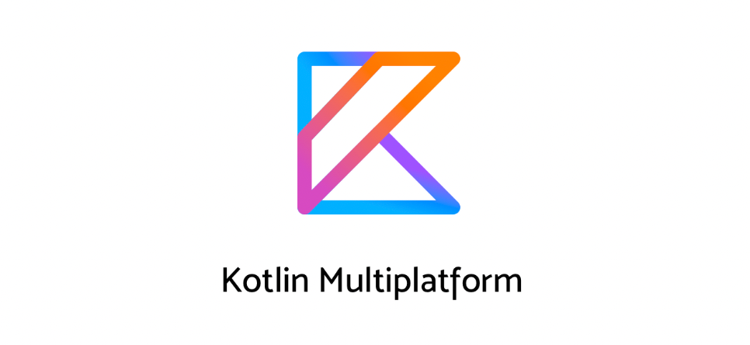

Slide 8
Java Applications
Java is used in various sectors, including web development, enterprise applications, Android app development, and more.

Slide 9
Java's Community
A large, active community provides extensive support, resources, and libraries, making Java development easier.

Slide 10
Thank You!

Slide 11
Summary & Next Steps
This presentation covered key aspects of java .
Next Steps:
1. Review the content.
2. Prepare supporting materials.
3. Engage with your audience!

